Slide 1
Evolution of HPC

Slide 2
Evolution of HPC System
Memory
Memory
Memory
Memory
…….
CPU
CPU
CPU
CPU
CPU
NETWORK
Sequential program
Mega Flops
Shared Memory
Giga Flops
Parallel programs using OpenMP and MPI
Multiple nodes
Tera Flops
Infiniband (200Gbps)
Distributed memory

Slide 3
Architecture innovations
Architecture innovations
Width: 8 bit to 16 bit to 64 bit
Multicore: single processor to multi cores
Instructions per cycle: 4-10 cycles per instructions to 4+ instructions per cycle
Clock rate : 3MHz to 4GHz

Slide 4
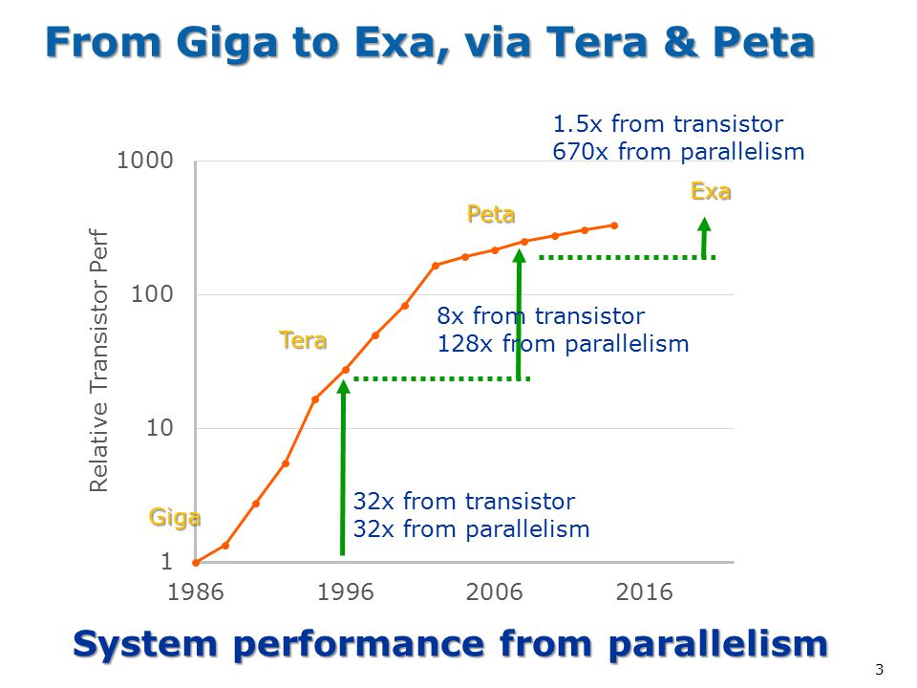
System performance from parallelism
https://www.exascaleproject.org/

Slide 5
Profiling

Slide 6
Profiling
Analyzing the behavior and performance of software applications running on HPC systems
It involves collecting detailed information about the program's execution to identify hotspots, inefficiencies, and potential areas for optimization
Ensuring efficient use of CPU, memory, I/O, and network resources

Slide 7
Profiling
Execution time of functions
Hotspots
CPU time
I/O usage
Memory utilization
Cache hits and misses
Loops
Communication patterns

Slide 8

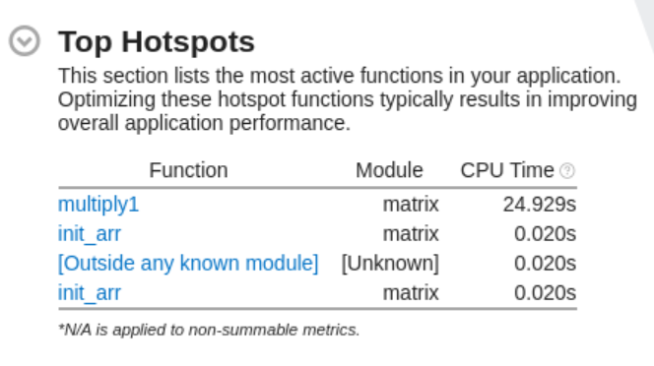
Primary goal of profiling

Slide 9
Profiling
There are two common techniques used in application profilers to collect data about the execution of an application:
Instrumentation
Sampling

Slide 10
Instrumentation
Instrumentation is a profiling technique where additional code is inserted into a program to collect performance data as it runs.
This extra code, often added at compile time or dynamically at runtime, helps gather detailed information about the execution of specific functions, memory usage, or other aspects of the program's behavior

Slide 11
Types of instrumentation
Manual Instrumentation: Developers manually insert profiling code into the application source code. This can be highly specific but is labor-intensive and prone to human error
Automatic Instrumentation: Profiling tools automatically insert the necessary code. This can be done at various stages, such as during compilation, linking, or even at runtime. Automatic instrumentation is less error-prone and more scalable

Slide 12
How instrumentation works
Function Entry/Exit Logging: Code is inserted at the entry and exit points of functions to log when they start and finish
Event Logging: Specific events (e.g., memory allocations, I/O operations) are logged
Counters and Timers: Code to count occurrences of specific events or measure the time spent in functions or code blocks

Slide 13
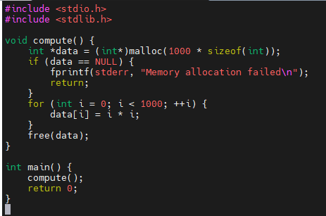
Example

Slide 14
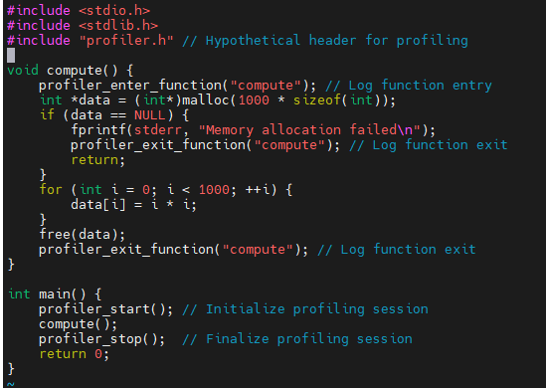
Example

Slide 15
Sampling
Sampling in profiling is a technique used to gather performance data by periodically recording the state of a program during its execution
Unlike instrumentation, which inserts additional code into the application to collect detailed metrics, sampling captures snapshots of the program's state at regular intervals

Slide 16
CPUs vs GPUs

Slide 17
CPU vs GPU : Silicon Budget
Number of transistors
 | CPU | GPU
ALU | Less | More
Control | More | Less
Cache | More | Less

Slide 18
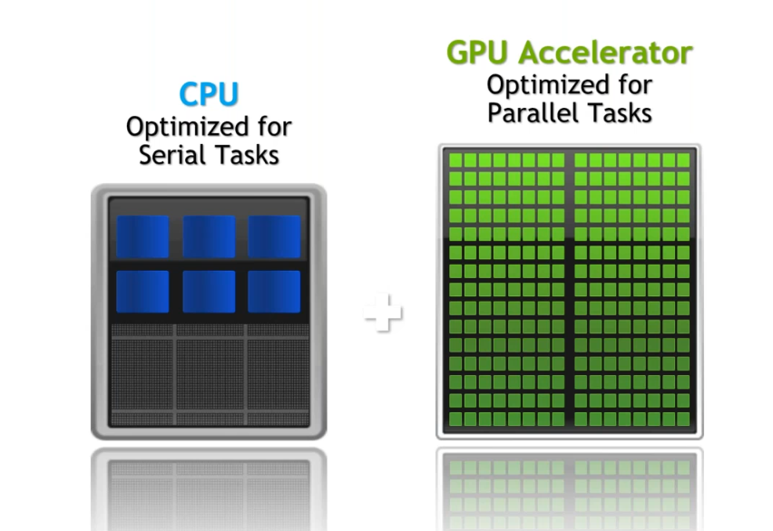
CPU vs GPU : Silicon Budget

Slide 19
CPU vs GPU
CPU | GPU
Small number of large cores | Large number of small cores
Low latency | High throughput
Optimized for serial processing | Optimized for parallel processing
Designed for running complex programs | Designed for repetitive calculations
Cost efficient for smaller workloads | Cost efficient for bigger workloads

Slide 20
Writing shell script
mytool --collect=profiling --generation=<input1> --my-directory=<input2> -- <input3>

Slide 21
SPACK

Slide 22
SPACK
Spack is a powerful package manager designed for high-performance computing (HPC) environments
It excels at managing multiple versions, configurations, and dependencies of scientific software packages, ensuring compatibility with various platforms, compilers, and libraries
Spack allows for the creation of custom software packages

Slide 23
SPACK
Multi-version and Configuration Support: Spack allows you to install and maintain different versions of the same package with distinct configurations, fostering flexibility in your development workflow.
Platform and Compiler Independence: Spack functions seamlessly across various computing platforms, including Linux, macOS, and HPC clusters with unique architectures. It can build software using different compilers (e.g., GCC, Clang) to cater to specific requirements.
Non-destructive Installations: Unlike some package managers, Spack installs new versions of a package without affecting existing installations. This enables multiple configurations to coexist on your system, preventing conflicts.

Slide 24
SPACK installation
git clone https://github.com/spack/spack.git
cd spack
source /home/cdacapps01/himanshu/spack/share/spack/setup-env.sh

Slide 25
Application installation using SPACK
spack list hpctoolkit
spack list | grep hpctoolkit
spack find hpctoolkit
spack info hpctoolkit
spack spec -I hpctoolkit
spack install -v -j40 hpctoolkit

Slide 26
Intel Offload Advisor

Slide 27
Agenda
Intel offload advisor - Purpose
Working of Intel offload advisor
Workflows available in offload advisor
How to generate offload advisor report
Offload modeling report overview

Slide 28
Intel Offload Advisor - Purpose
Find opportunities to offload/run your code on a target GPU
Identify potential performance hotspots on a target GPU
Measures performance of your application and compares it with its modeled performance on a selected target GPU so that you can decide what parts of your application you can execute on the GPU and how you can optimize it to get a better performance after offloading.

Slide 29
Intel Offload Advisor - Purpose (Contd.)
The Offload Modeling perspective can mainly help you in the following:
Determine if you should offload your code to a target device
Estimate potential speedup from running it on a different target
Identify loops recommended for offloading
Identify potential performance bottlenecks on the target device
Check how effectively data can be transferred between host and target devices.

Slide 30
Working of Offload Advisor
The Offload Modeling perspective runs the following steps:
Survey analysis - Get the baseline performance data for your application
CPU Utilization
Memory transfer and allocation
Data transfer patterns
Hotspots

Slide 31
Working of Offload Advisor
The Offload Modeling perspective runs the following steps:
2. Characterization analysis - Identify:
kernels invoked and executed
estimate cache and memory traffics on target device memory

Slide 32
Working of Offload Advisor
The Offload Modeling perspective runs the following steps:
3. Dependencies analysis - identify loop-carried dependencies that might block parallel execution

Slide 33
Working of Offload Advisor
The Offload Modeling perspective runs the following steps:
4. Performance Modeling - Estimate total program speedup on a target device and other performance metrics. Region is profitable if its execution time on the target is less than on a host.

Slide 34
Workflows in Offload Advisor
CPU-to-GPU offload modeling
profile an application running on a CPU and model its performance on a target GPU device to determine if you should offload parts of your application to the GPU
GPU-to-GPU offload modelling
profile an application running on a GPU and model its performance on a different GPU device to estimate a potential speedup from running your application on the different target

Slide 35
Run Offload Advisor
Set up the Intel Advisor environment variables
source /opt/intel/oneapi/setvars.sh
or
module avail | grep advisor
module load oneapi/advisor/2021.3.0
or
<installation using spack>

Slide 36
Run Offload Advisor
Installation using spack
Step 1 : spack installation
git clone https://github.com/spack/spack.git
cd spack
git checkout releases/v0.19
// locate setup-env.sh
// cd share/spack
// source setup-env.sh
source /home/cdacapp/Himanshu/spack/share/spack/setup-env.sh
spack --version

Slide 37
Run Offload Advisor
Installation using spack
Step 1 :install and load intel offload advisor
spack list advisor
spack install -v -j40 intel-oneapi-advisor
spack find intel-oneapi-advisor
spack load intel-oneapi-advisor
advisor

Slide 38
Run Offload Advisor
Run advisor command
advisor --collect=offload --config=gen11_icl --project-dir=./mmul_report -- ./mmult_serial

Slide 39
Run Offload Advisor
Run advisor command
advisor --collect=offload --config=gen11_icl --project-dir=./mmul_report – ./mmult_serial
Analyzes your application total execution time and execution time of its loops/functions using the Survey analysis
Counts how many iterations each cycle performs during application runtime using Characterization analysis
Estimates execution time for code regions that can be offloaded to a target GPU and total time to transfer data from CPU to target GPU using the Performance Modeling analysis

Slide 40
Run Offload Advisor
advisor --collect=offload --dry-run --config=gen11_icl --project-dir=./mmul_report -- ./mmult_serial
// it will run 3 internal commands
advisor --collect=survey --auto-finalize --static-instruction-mix --project-dir=./mmul_report -- ./mmult_serial
advisor --collect=tripcounts --flop --stacks --auto-finalize --cache-simulation=single --data-transfer=light --target-device=gen11_icl --project-dir=./mmul_report -- ./mmult_serial
advisor --collect=projection --no-assume-dependencies --config=gen11_icl --project-dir=./mmul_report -- ./mmult_serial

Slide 41
Run Offload Advisor (Cont)
Accuracy levels
--accuracy= Low/Medium/High

Slide 42
Run Offload Advisor (Contd…)
Accuracy levels
--accuracy= low/medium/high
Low Accuracy: This level requires minimal analysis, so the overhead is minimal (typically 5x to 10x slower than your original code). It focuses on basic execution time and floating-point operations, which are relatively quick to calculate
Medium Accuracy (default): This level adds more analysis, including cache simulation and estimates of data transfer between CPU and GPU. These simulations require additional processing power, leading to moderate overhead (typically 15x to 50x slower than your original code)
High Accuracy: This level performs the most extensive analysis, including detailed cache simulation, more refined data transfer estimates, and dependency analysis (for CPU applications). These complex simulations are computationally expensive, resulting in the highest overhead (typically 50x to 80x slower than your original code)

Slide 43
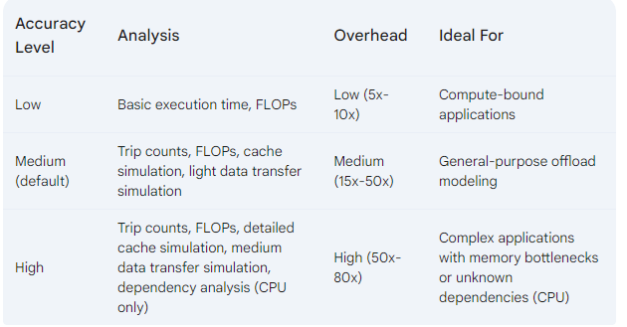
Run Offload Advisor (Cont)
Accuracy levels : --accuracy= Low/Medium/High
overhead refers to the additional processing time and resources required to perform the more detailed analyses

Slide 44
Run Offload Advisor (Cont)
Accuracy levels
--accuracy= Low/Medium/High
advisor --collect=offload –accuracy=medium --config=gen11_icl --project-dir=./mmul_report – ./mmult_serial

Slide 45
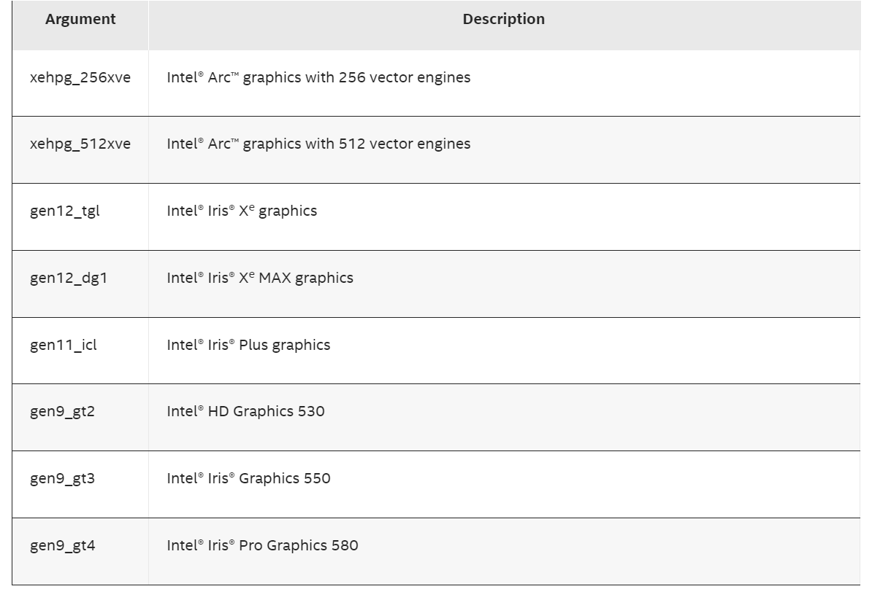
Run Offload Advisor (Cont)
Select target platform using --config
--config = <option>

Slide 46
Offload modeling report overview
Top Metrics & Program Metrics
performance estimations and comparison with the baseline application performance on CPU
Offload Bounded By
factors that limit the performance of regions in relation to their execution time
Top Offloaded
top regions recommended for offloading to the selected target device
Top Non-Offloaded
top regions not recommended to be run on the target device

Slide 47
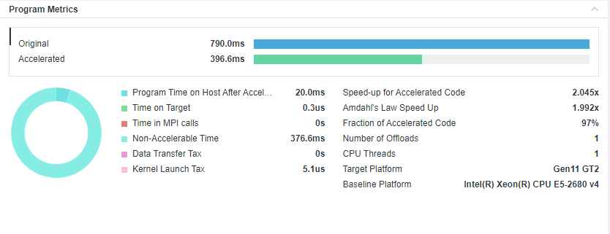
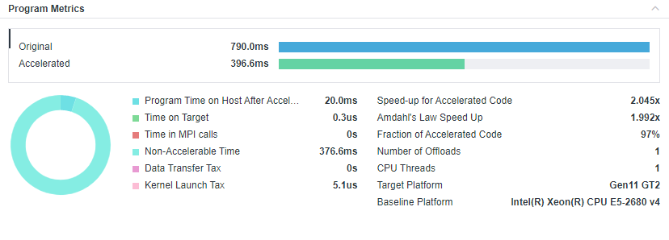
Intel advisor tells you…
How your code might perform on an accelerator?

Slide 48
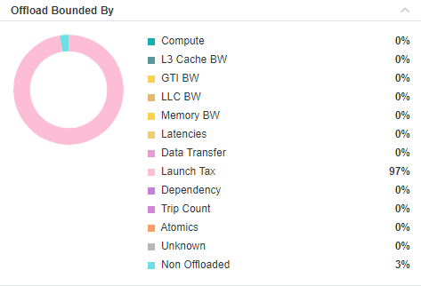
Intel advisor tells you…
What might be limiting your performance on the accelerator?

Slide 49
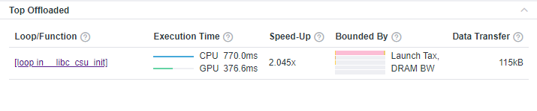
Intel advisor tells you…
What should you offload?

Slide 50
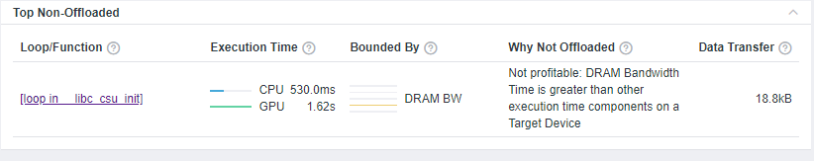
Intel advisor tells you…
What you should not offload and why?

Slide 51
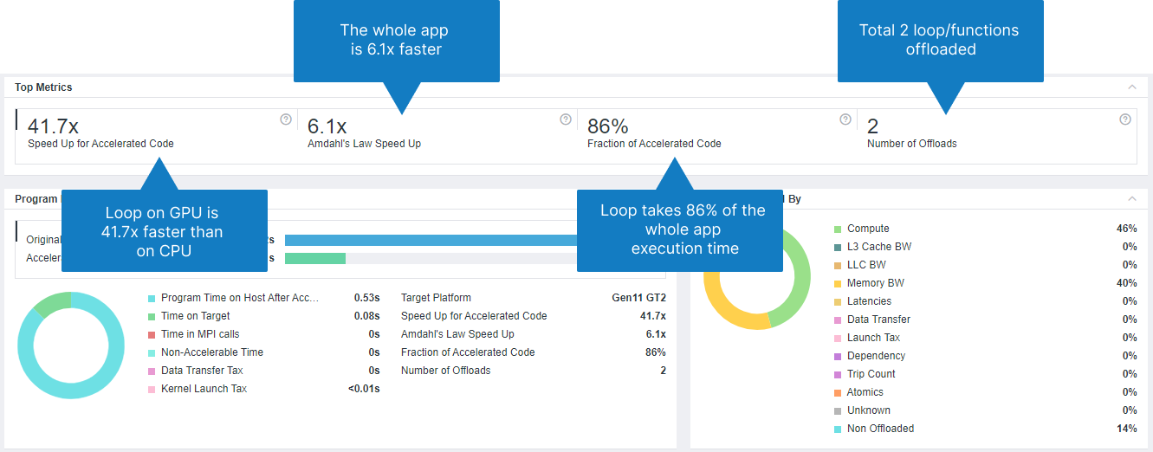

Slide 52
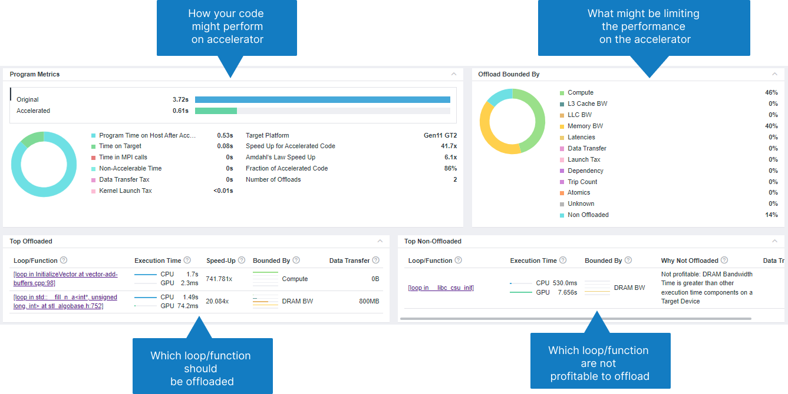

Slide 53
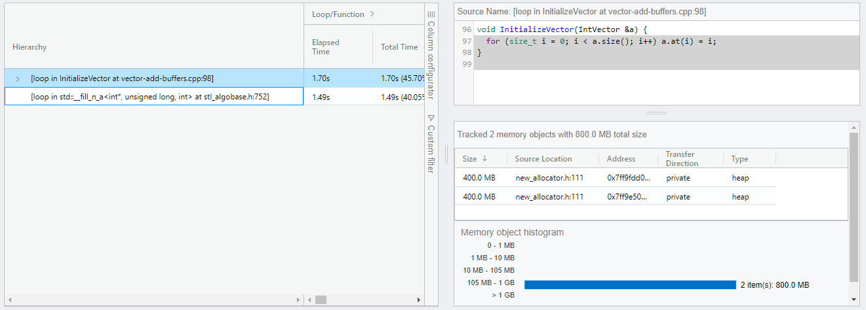
Top offloaded regions
Timings (total time, time on the accelerator, speedup)
Offload metrics (offload tax data transfers)
Memory traffic (DRAM, L3, L2, L1), trip count

Slide 54
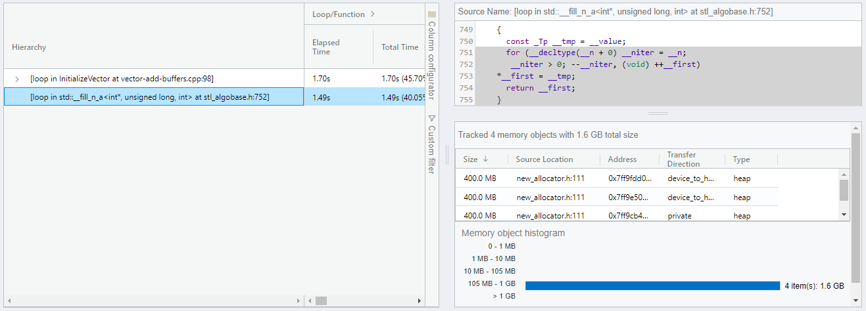
Top offloaded regions
Timings (total time, time on the accelerator, speedup)
Offload metrics (offload tax data transfers)
Memory traffic (DRAM, L3, L2, L1), trip count

Slide 55
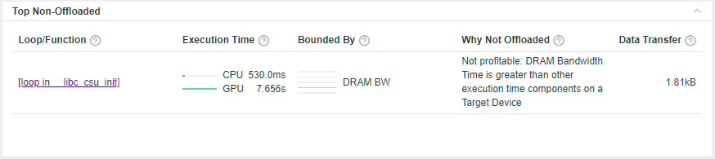
Top Non-offloaded Regions
Dependency issues
Not profitable/ less number of loops or iterations
Total execution time of function is too small

